Slide 1
Brain Tumor Detection using PyTorch
-RAKSHAVIHASINI A S
(2021503543)

Slide 2
PROBLEM STATEMENT
Brain tumors are a significant health concern, with early detection playing a crucial role in patient prognosis and treatment outcomes.
Manual interpretation of medical images for brain tumor detection is time-consuming and subject to human error.
The aim of this project is to develop a deep learning-based solution using PyTorch Convolutional Neural Networks (CNNs) to automate the detection of brain tumors in MRI scans.

Slide 3
PROJECT OVERVIEW
Our project, "Brain Tumor Detection using PyTorch CNN," employs deep learning techniques to automate brain tumor detection in MRI scans.
Leveraging PyTorch's CNN modules, we aim to develop an accurate model for analyzing medical images and identifying tumors.
The project involves data collection from MRI databases, preprocessing to enhance image quality, model training, and evaluation.
By utilizing a curated dataset of MRI images annotated with tumor labels, our goal is to contribute to improved diagnostic capabilities in neurology.

Slide 4
END USERS
The end users of our brain tumor detection system include:
Radiologists and healthcare professionals specializing in neurology, who can utilize the automated detection system to assist in the interpretation of MRI scans.
Medical institutions and hospitals, where the system can be integrated into existing diagnostic workflows to streamline the detection process and improve patient care.
Additionally, patients who undergo MRI scans for suspected brain tumors can benefit from the system by receiving faster and more accurate diagnoses, leading to timely treatment and improved outcomes.

Slide 5
SOLUTION
Data Collection: Gather a diverse dataset of MRI images containing both tumor and non-tumor cases.
Data Preprocessing: Preprocess the MRI images to enhance quality, remove noise, and standardize format for input into the CNN model.
Model Development: Design and implement a CNN architecture using PyTorch to learn and extract features from the preprocessed MRI images.
Training: Train the CNN model on the labeled dataset using appropriate loss functions and optimization algorithms to learn the patterns associated with brain tumors.
Evaluation: Evaluate the trained model's performance using metrics such as accuracy, sensitivity, specificity, and area under the curve (AUC) on a separate validation dataset.
Deployment: Deploy the trained model into a user-friendly interface, enabling healthcare professionals to upload MRI scans and obtain automated tumor detection results.

Slide 6
PROPOSED SYSTEM
Data Acquisition and Preprocessing:
The dataset utilized in our project is obtained from reputable sources, ensuring a diverse representation of brain scans with and without tumors. These datasets undergo preprocessing steps to standardize format, enhance image quality, and remove noise.
Feature Extraction and Representation:
Using advanced techniques within the deep learning framework, we extract meaningful features from MRI images. These features serve as essential indicators for tumor presence and are represented in a structured format suitable for model training.

Slide 7
PROPOSED SYSTEM
Model Development and Training:
Our system entails the design and implementation of a custom CNN architecture optimized for brain tumor detection tasks. This architecture includes convolutional layers for feature extraction and fully connected layers for classification.
The model is trained on the preprocessed MRI datasets, utilizing techniques such as mini-batch gradient descent and backpropagation to adjust model parameters iteratively.
Evaluation and Validation:
We evaluate the performance of the trained model using validation datasets, assessing metrics such as accuracy, sensitivity, specificity, and area under the curve (AUC).
Rigorous validation ensures the robustness and reliability of the model in accurately detecting brain tumors across diverse datasets and scenarios.

Slide 8
PROPOSED SYSTEM
Deployment and Integration:
Upon successful training and validation, the trained model is deployed into a user-friendly interface accessible to healthcare professionals.
Integration with existing healthcare systems enables seamless incorporation of the brain tumor detection solution into clinical workflows, facilitating efficient diagnosis and treatment planning.
Continuous Improvement and Adaptation:
Our system is designed for continuous improvement and adaptation, incorporating feedback from users and updates in medical imaging technology.
Ongoing research and development efforts focus on enhancing model performance, expanding dataset diversity, and addressing emerging challenges in brain tumor detection.

Slide 9
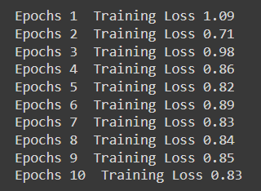
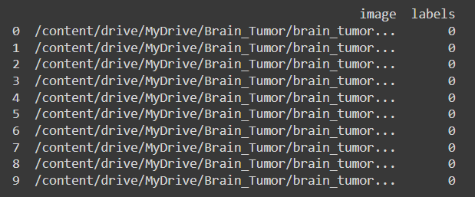
RESULTS
Training data
Printing dataset

Slide 10
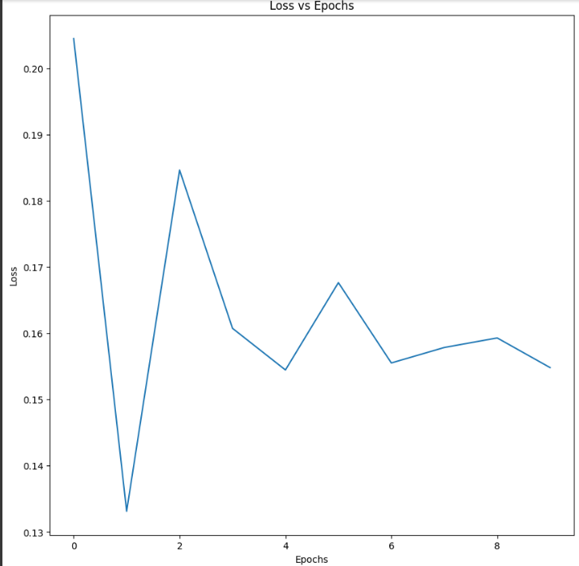
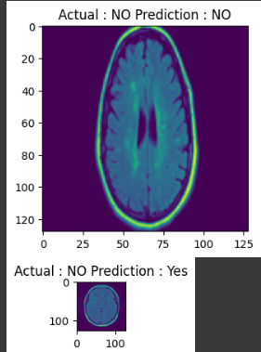
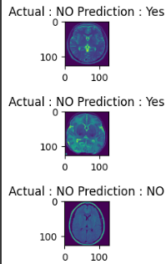
RESULTS
Prediction of brain tumor

